Slide 1
BIWO-04 Numerical methods Assignment
PEG SOLITAIRE
Done By:
Anvar Mohamed Aslam Sha

Slide 2
Program 1 Random Number Approach

Slide 3
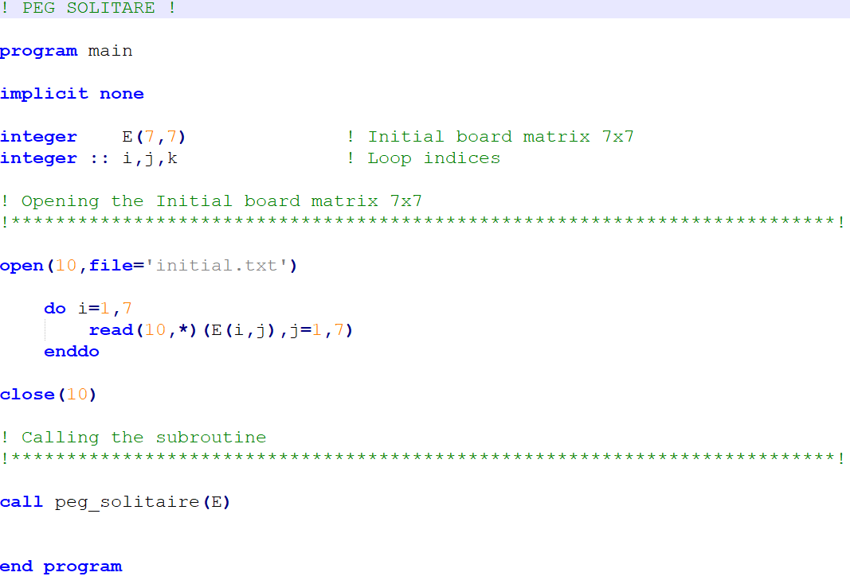
MAIN PROGRAM (Initial Matrix declaration)

Slide 4
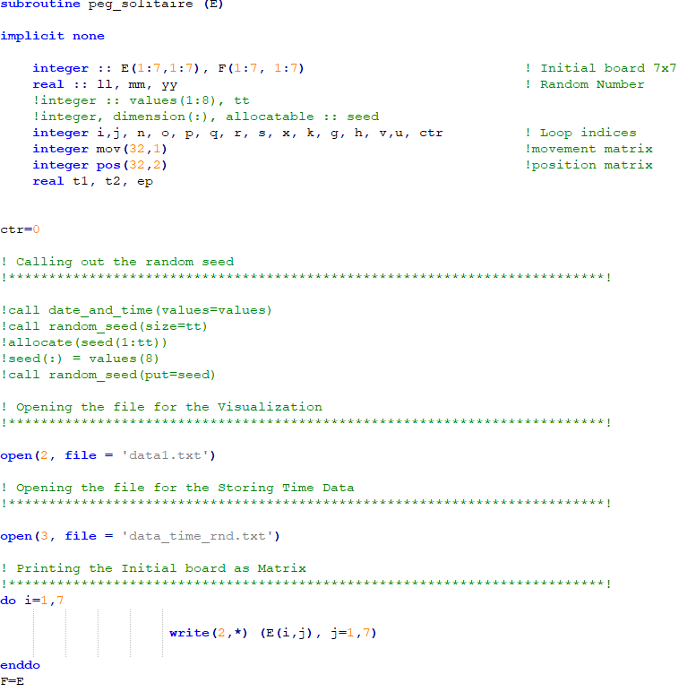
SUBROUTINE – Part 1 (Variables and Data types)

Slide 5
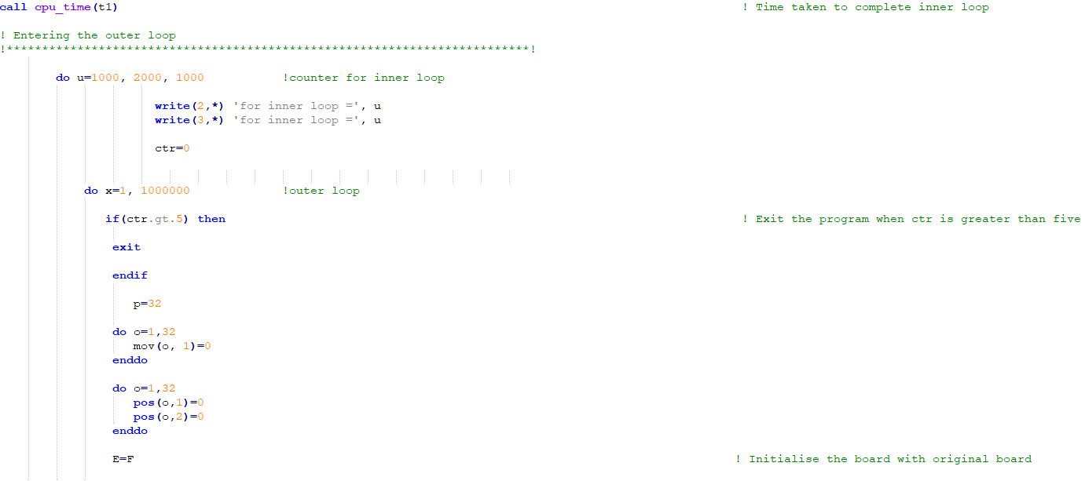
SUBROUTINE – Part 2 (Counter for inner loop, outer loop, Declaration)

Slide 6
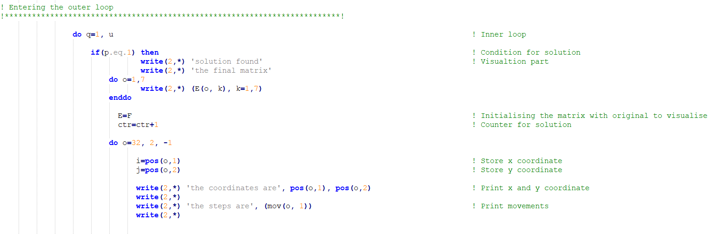
SUBROUTINE – Part 3 (Printing Coordinates and Steps for solutions)

Slide 7
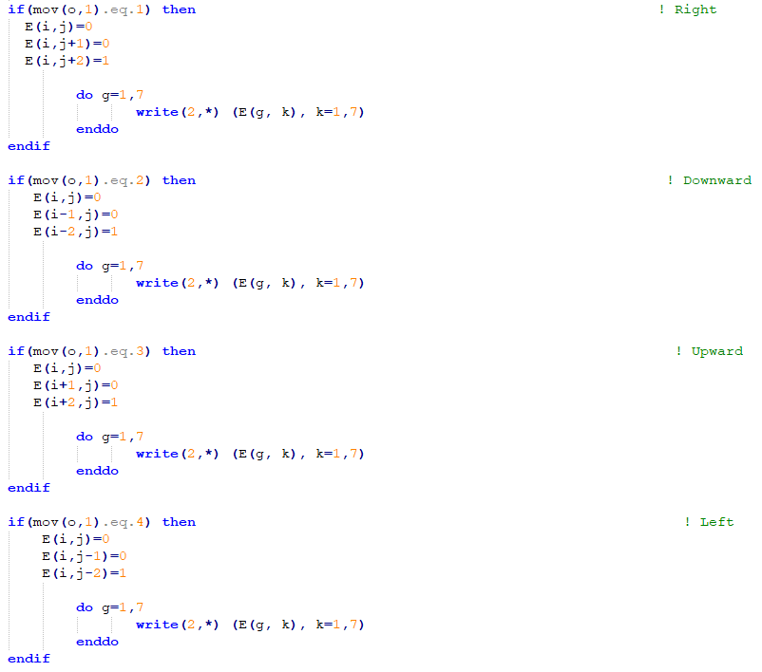
SUBROUTINE – Part 4 (Printing Matrices for each step)

Slide 8
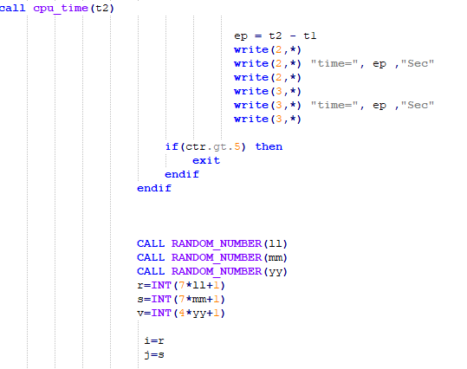
SUBROUTINE – Part 5 (Computational Time and Random number function)

Slide 9
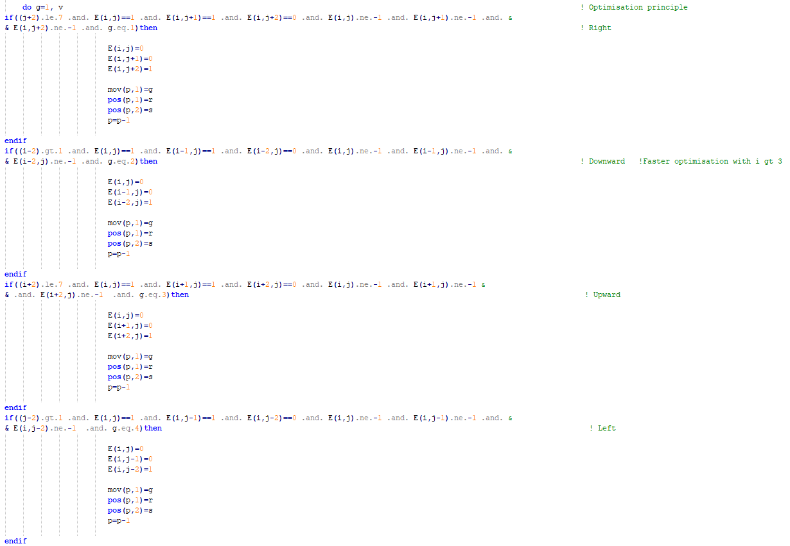
SUBROUTINE – Part 6 (Movements for successful jumps)

Slide 10
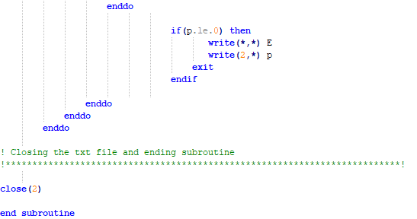
SUBROUTINE – Part 7 (Anomaly Check)

Slide 11
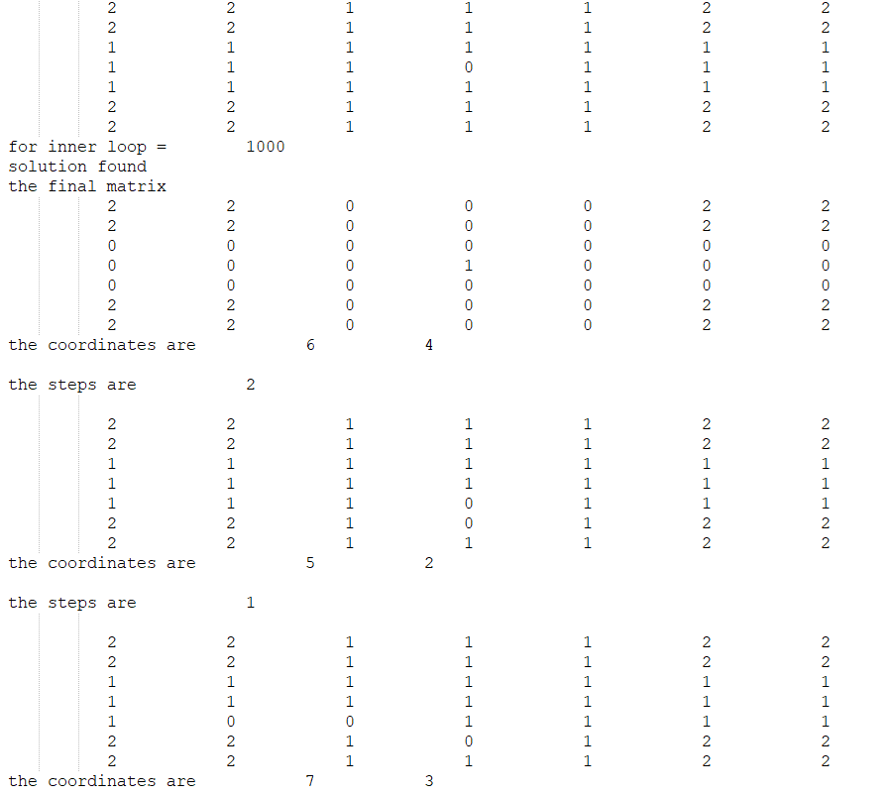
OUTPUT – For One solution

Slide 12
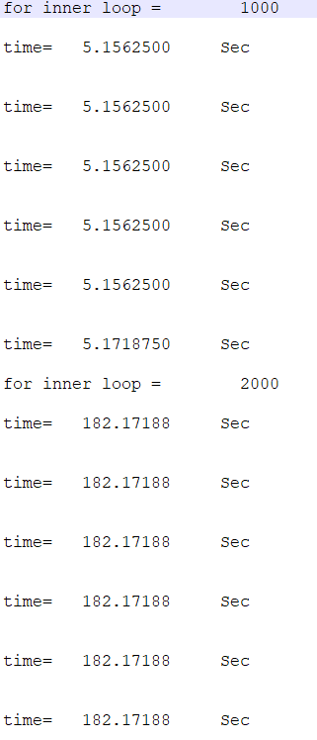
OUTPUT – Time taken for each solution

Slide 13
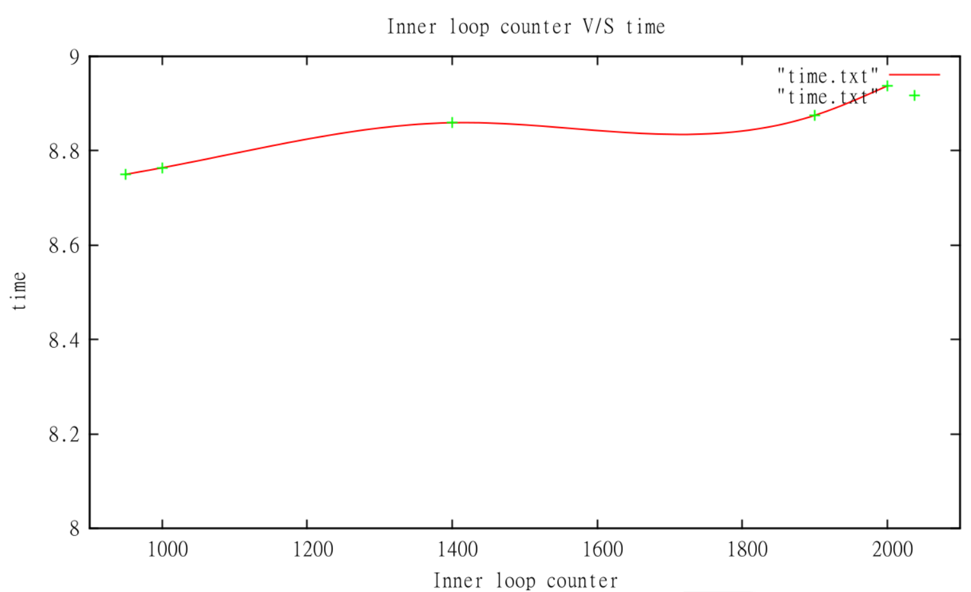
GRAPH – Task 3 (GNUPLOT)

Slide 14
Program 2 Using Recursive Function

Slide 15
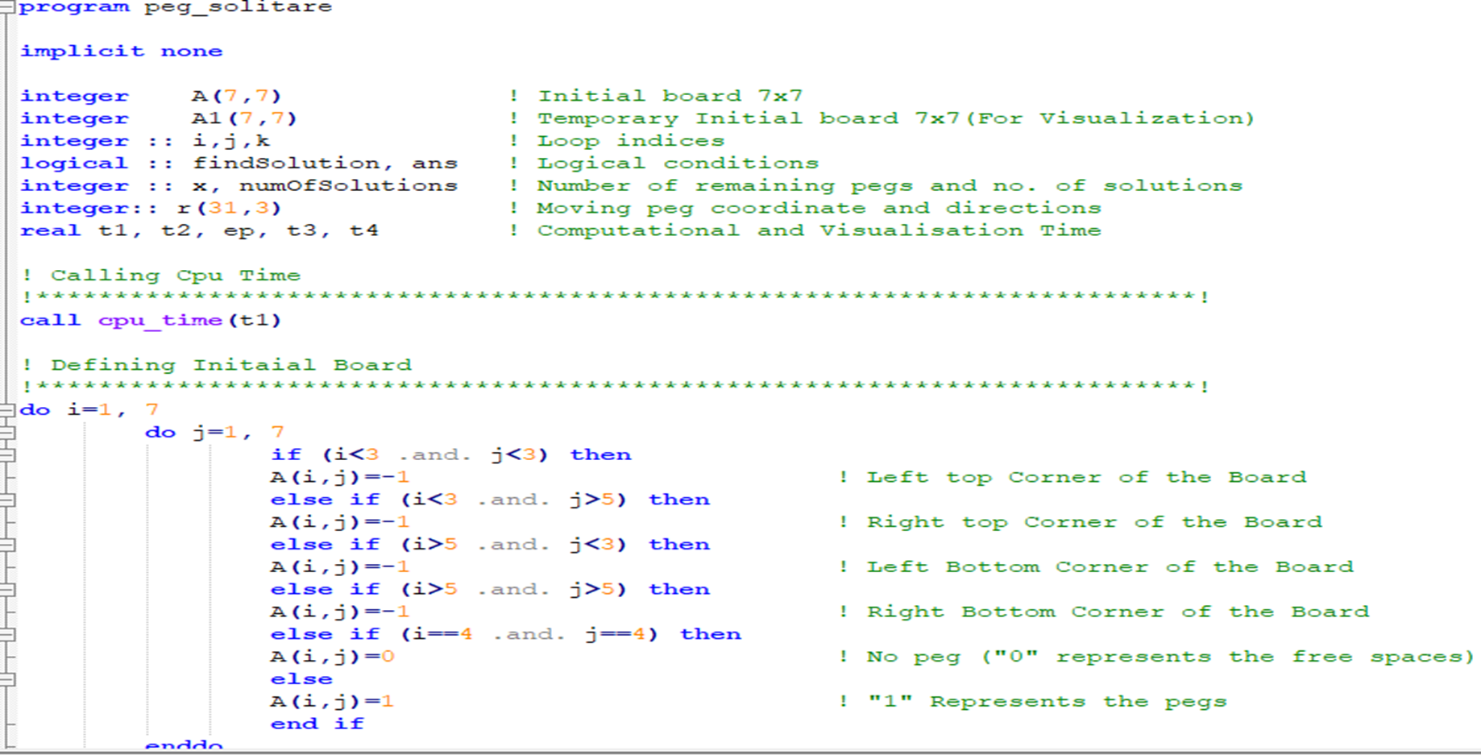
MAIN PROGRAM (Initial Matrix declaration)

Slide 16
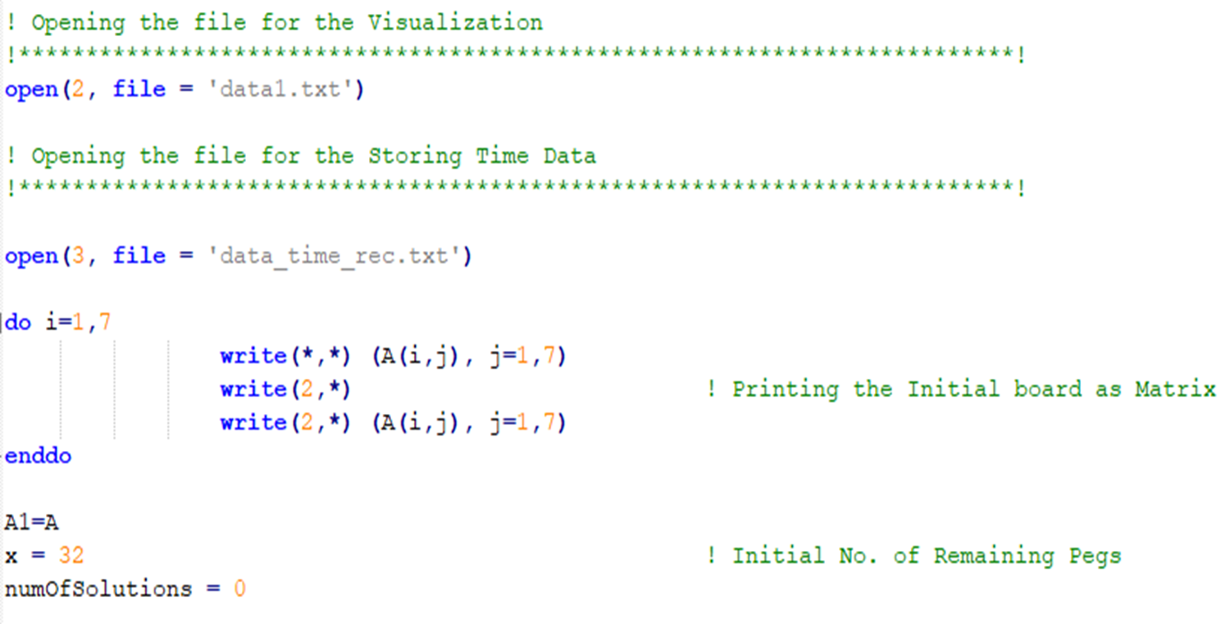
Opening file for Visualization

Slide 17
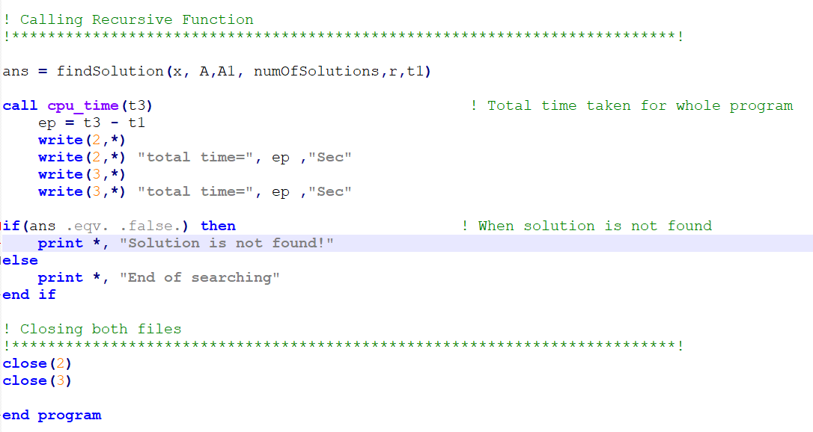
Calling Recursive Function

Slide 18
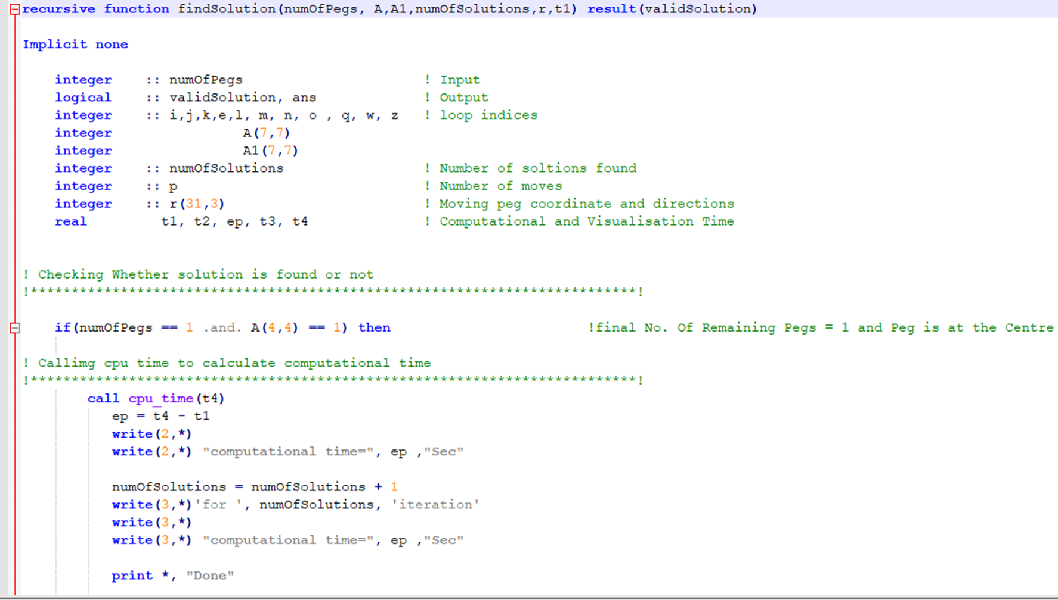
Recursive Function

Slide 19
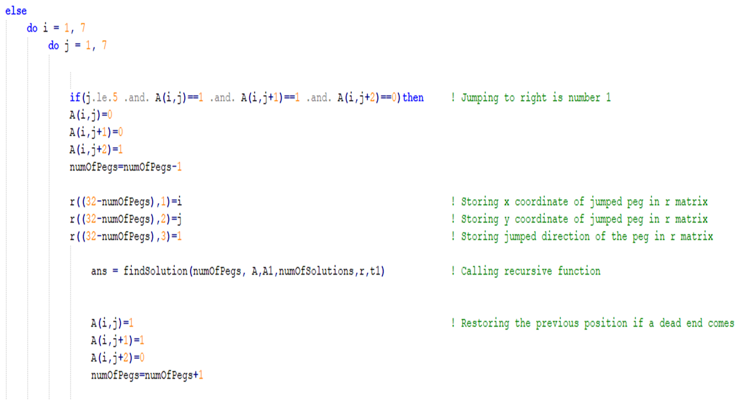
Movement of Pegs (part 1)

Slide 20
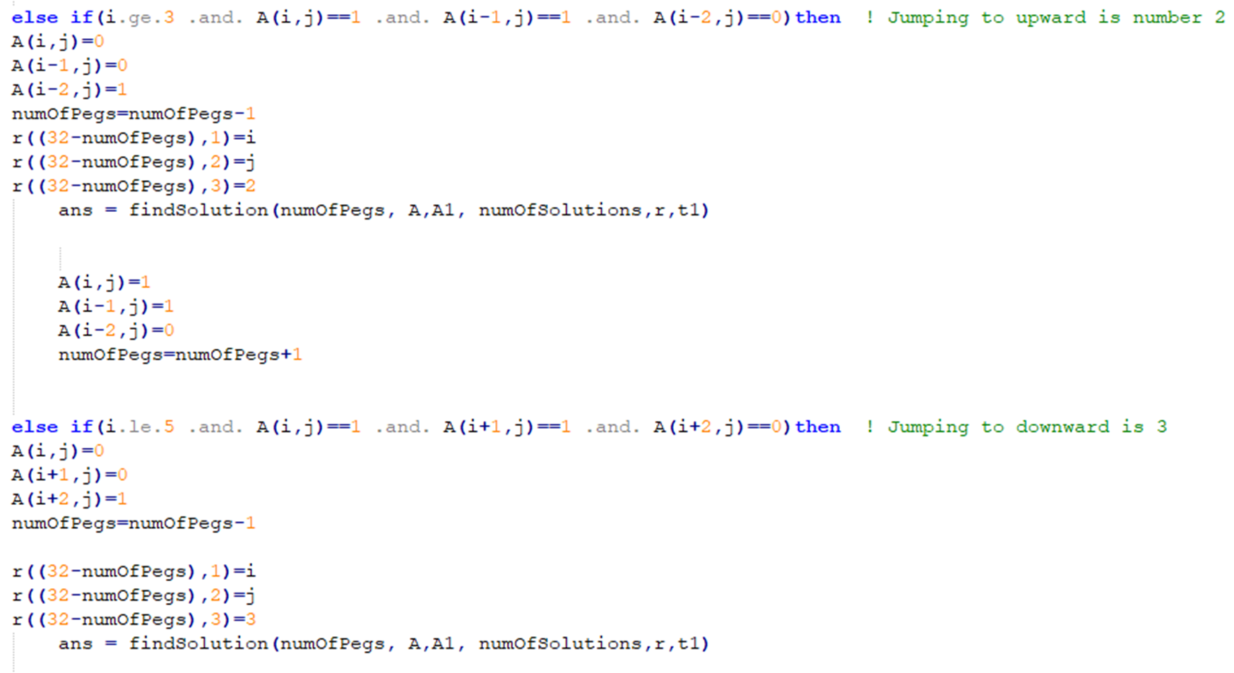
Movement of Pegs (part 2)

Slide 21
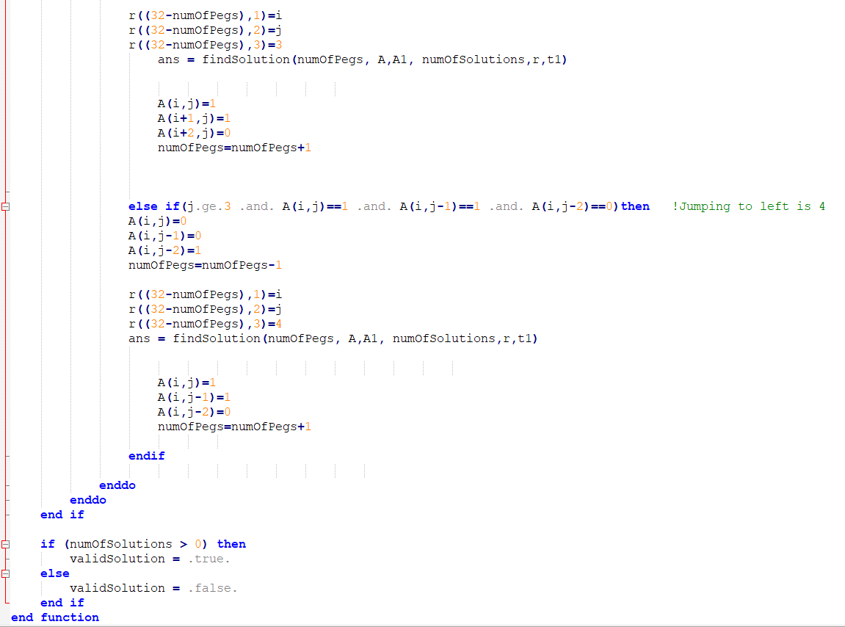
Movement of Pegs (part 3)

Slide 22
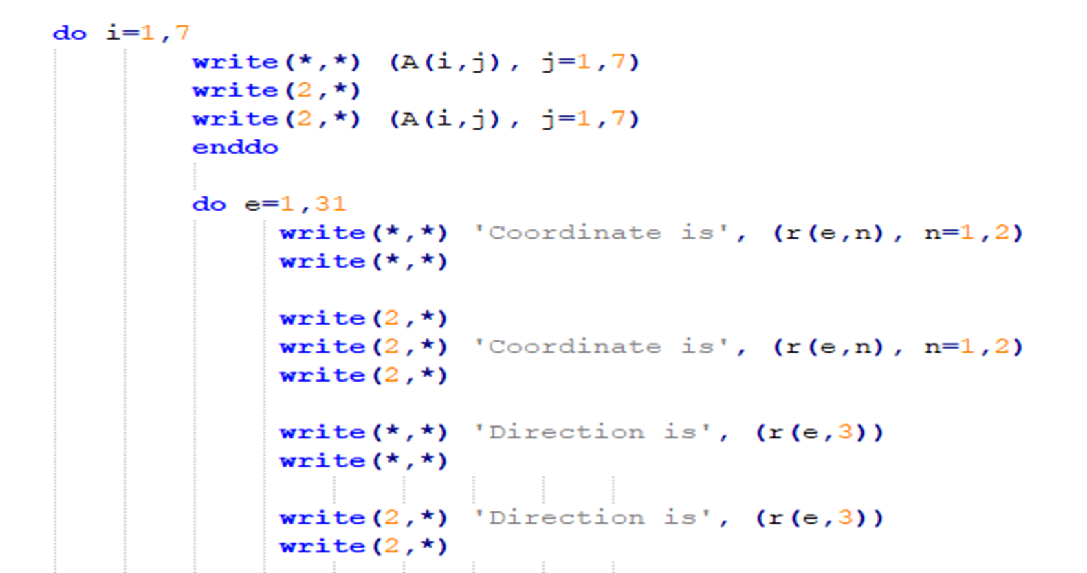
Visualization Part 1

Slide 23
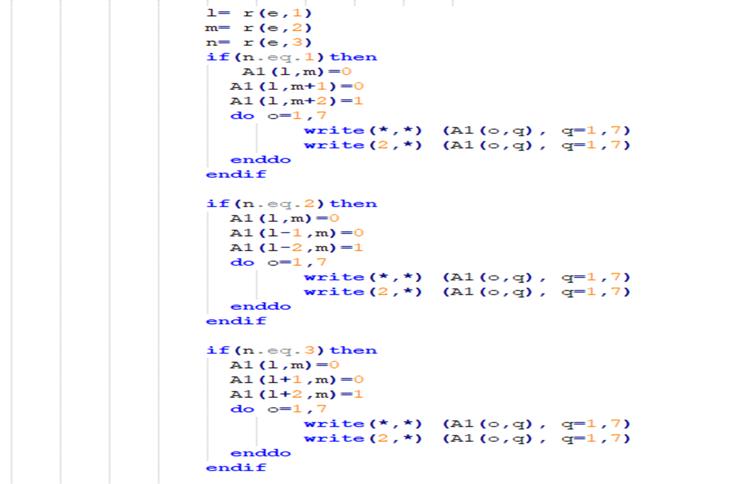
Visualization Part 2

Slide 24
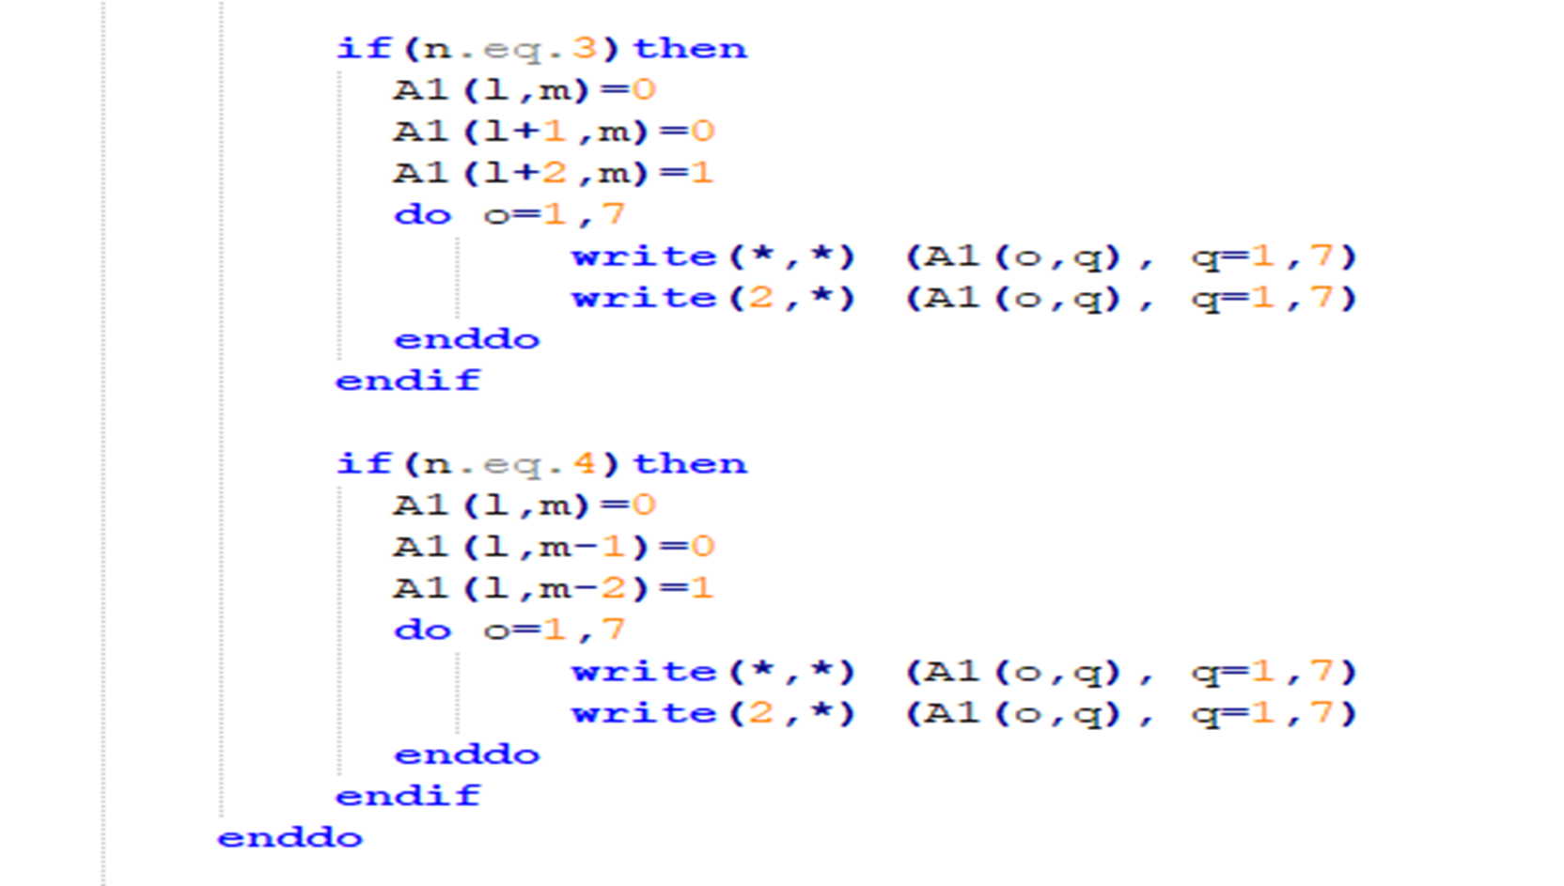
Visualization Part 3

Slide 25
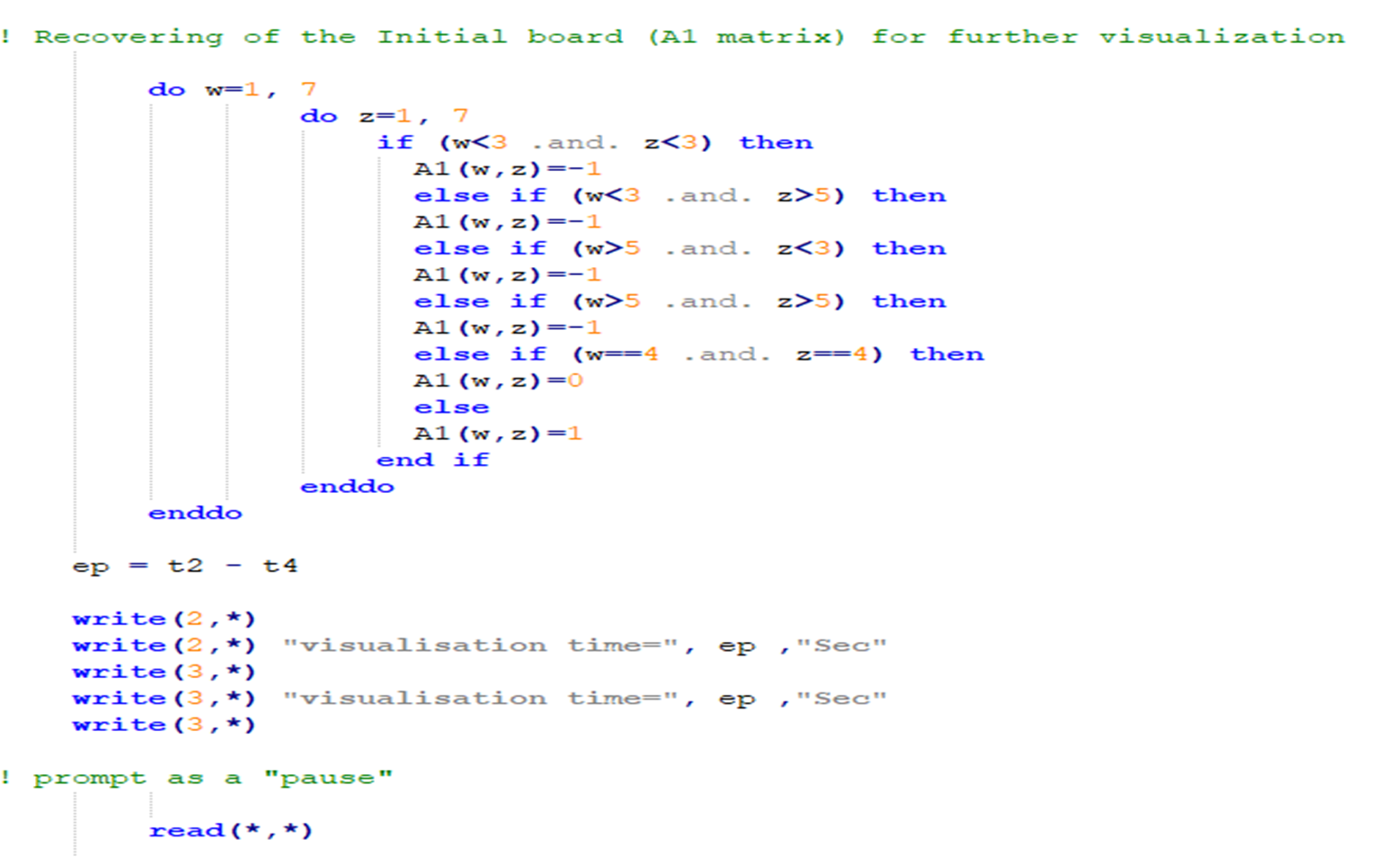
Recovering of the initial board

Slide 26
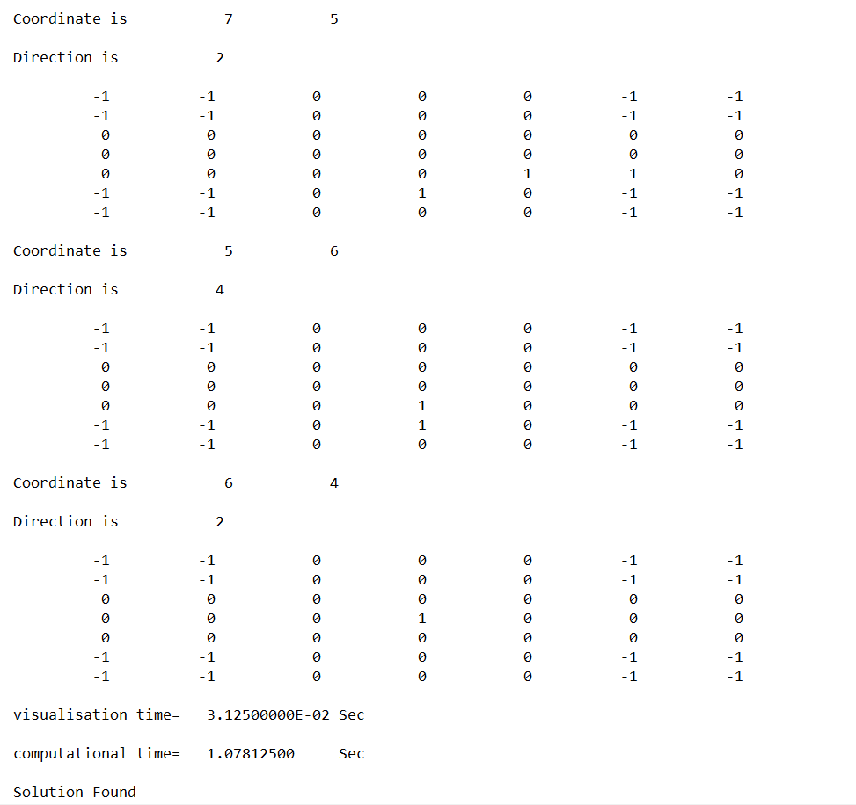
OUTPUT – For One solution

Slide 27
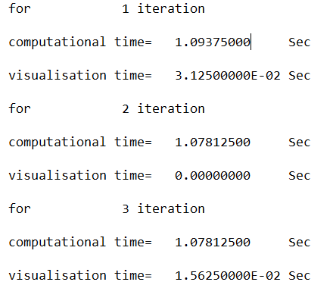
OUTPUT – Time taken for each iteration

Slide 28
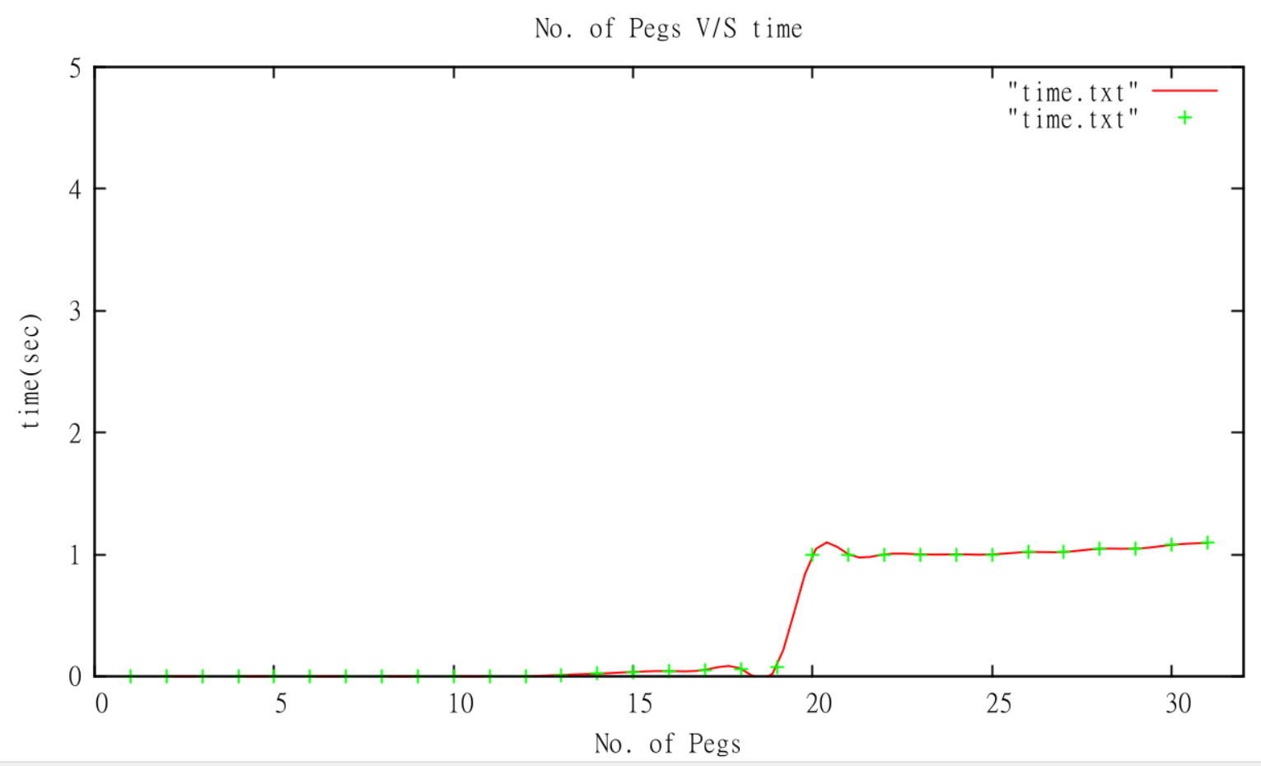
GRAPH – Task 3 (GNUPLOT)

Slide 29
Thank You

